Slide 1

Volumetric Left Ventricle segmentation of MPI SPECT IMAGES with self-supervised learning
Author: Kristóf Máté Horváth
Supervisor: Ádám István Szűcs

Slide 2
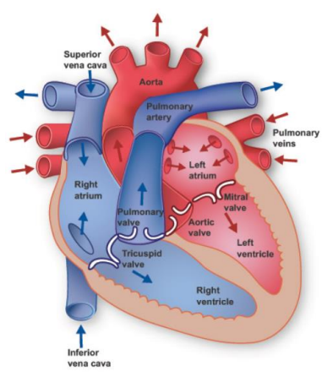
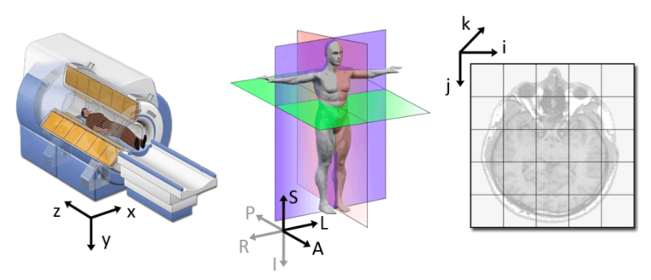
Single Photon Emission Computerized Tomography (SPECT)
Left ventricular function is assessed through Myocardial Perfusion SPECT (MPS)
The fidelity of the left ventricular function assessment is directly dependent on the quantification accuracy of the left ventricular myocardium volume.
Manual segmentation is tedious, depends on the observer’s expertise. Supervised learning requires large number of labels, which requires specialized experts.
The solution is self-supervised learning.
Digital Imaging and Communications in Medicine (DICOM) – standard for storing and transmitting medical images.
World, anatomical and medical image coordinate systems.
Human position is described by three planes: axial, sagittal, and coronal plane.

Slide 3

Thesis hypothesis:
General feature detectors can be trained on 3D SPECT images, for left ventricle segmentation, with self-supervised learning algorithms to reduce the high number of label requirement of pure supervised learning methods.

Slide 4
Frameworks for self-supervised representation learning
Self-supervised learning (SSL) consists of a pretext and a target task.
Pretext tasks generally synthesize labels from the un-labelled data that can be used to train the network, which can consequently learn general features.
The general features can be used to optimize the network on a target task, using a small fraction of its original label requirement.
SSL algorithms are also called representation or feature learning algorithms.
SSL follows the paradigm of transfer-learning (pre-training and fine-tuning).

Slide 5
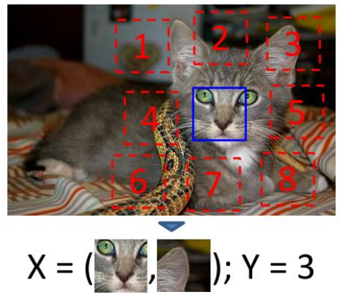
Relative patch location (RLP) pretext task
Visual representation learning from un-labelled data by Context Prediction
In the embedding or feature space semantically similar data points should be closer, while the semantically different data points should be farther away from each other.
Utilize the spatial context to extract free labels from un-labelled data, in order to learn visual representations in an SSL manner.
A grid of 3x3 patches is defined on an image. The starting coordinates of the grid (offset), gaps between the patches, and shifts among the patches are randomly sampled from pre-defined ranges.
The randomization process prevents shortcuts.
Shortcut is low-level statistics, that the model can exploit to solve the pretext-task, but as a consequence the model performs poorly on the target task, because it does not understand the global context.
Shortcuts include boundary patterns - edge-continuity and similar textures between the patches.
The centre patch is fixed, and another patch is randomly selected from the remaining 8 positions.

Slide 6
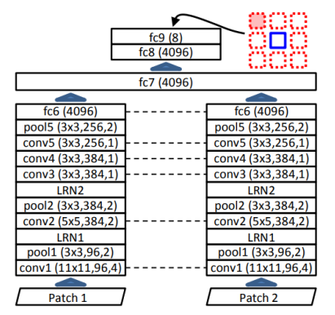
Relative patch location pretext task
Feeding the centre and random patch to the model in this order, its task is to correctly predict the relative location of the random patch with respect to the centre patch.
In other words, the network assigns a probability to each of the eight spatial configurations.
The network processes each patch separately one at a time until the fc6 layer, then it fuses the two embeddings before passing the fused information through the fc6-fc9 layers – shared layers and weights are applied to compute embeddings of the patches.

Slide 7
Solving jigsaw puzzles as a pretext task with context-free network (CFN)
The RLP pretext task introduces ambiguities to the model and affects its subsequent performance on the target task.
The association of each separate puzzle tile to a precise object part can be ambiguous, but these ambiguities can be eliminated when all tiles are observed at once, due to their mutual exclusiveness.
A permutation set is pre-computed (cardinality of 100, 500 and 1000) from the possible 9! permutations, by maximizing the average Hamming distance between each permutation – ensures that the tiles are shuffled sufficiently, and each tile of the same image has a chance to be assigned to different positions during the training epochs.
Increasing the cardinality of the permutation set up to a certain point, and increasing the Hamming distance reduces the ambiguity of the pretext task and correlates with the generalization capability of the model.
A 3x3 grid is defined based on the same randomized process, and tiles are extracted, then re-ordered by a randomly chosen permutation from the permutation set. This process happens again-again for each image in each training epoch.

Slide 8
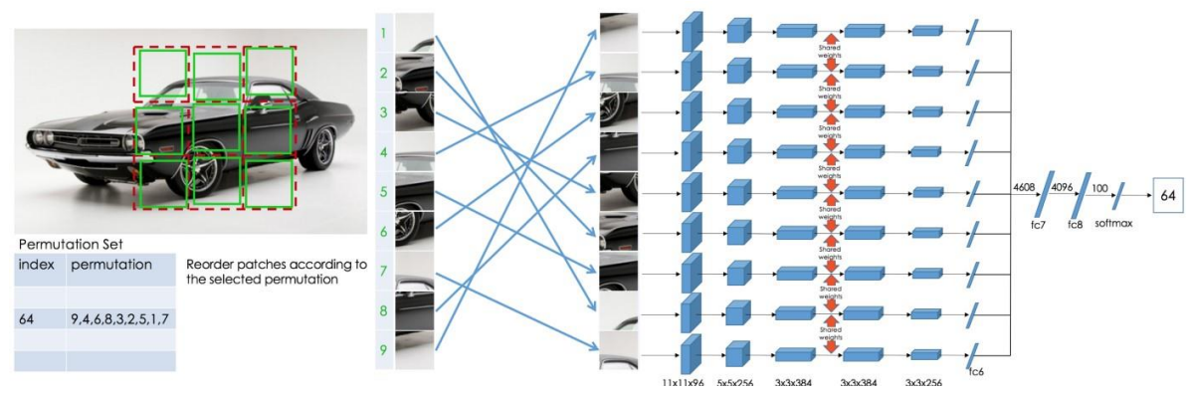
Solving jigsaw puzzles as a pretext task with context-free network
CFN computes features separately for each tile in the CNN part of the network, then observes the arrangements of the parts by concatenating the extracted features and passing them through the dense layers of the network.
The design forces the network to learn both representative and discriminative features for each object part, to determine their relative location of each object part with respect to each other.
The task of the network is to correctly predict the applied permutation that shuffled the tiles.
Research showed that the last convolutional layers specializes on solving the jigsaw puzzle, while the initial layers are general purpose. As a consequence, better performance can be obtained by training the last Convolutional layers on the target task.
Resulting training time is still a fraction of the purely SL method.
Good SSL algorithm nor simple nor ambiguous!

Slide 9
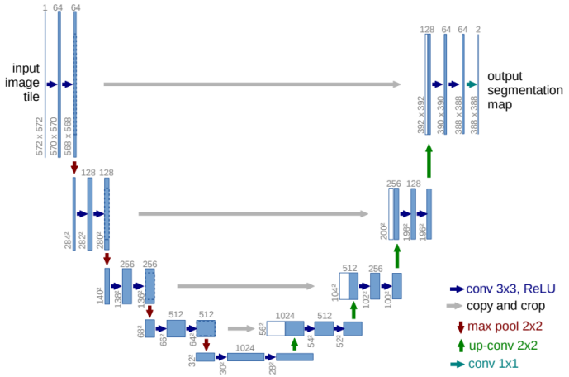
Architectures for segmentation
Image segmentation is a per pixel classification process.
Semantic segmentation classifies each pixel to a certain class. Instance segmentation uniquely differentiates between each object within the classes.
U-Net architecture was developed for biomedical image segmentation.
Researchers developed the network and the training framework to support the lack of annotated training examples.
They relied heavily on data augmentation techniques – transformations that increase the diversity of the training samples but at the same time they preserve the realistic nature of the data.
Elastic transformations are the most common variation in tissues and by introducing these transformations, the network can learn invariance and robustness to them without the existence of such data in the annotated image corpus.

Slide 10
U-Net for image segmentation
U-Net consists of an encoder path on the left, a bottleneck layer on the bottom, and a decoder path on the right on the image.
The encoding path / contractive path provides down-sampling with max-pooling layers, while at the same time the feature channels are doubled at each level.
The decoding path / expansive path increases the resolution of the down-sampled image by up-sampling, which reduces the number of feature maps at each level by half.
The high-resolution feature maps from the same level of the contractive path are concatenated together with the up-sampled feature maps – this information propagation serves localization – implemented via Skip Connections.
The number of feature maps at the end of the expansive path are reduced by 1x1 convolutions.
The output segmentation map of the network consists of as many channels as the number of classes are.
The architecture design yields a roughly symmetric architecture.

Slide 11
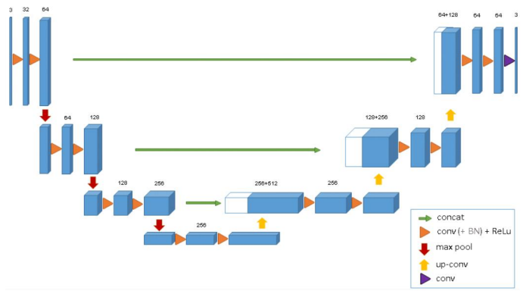
3D U-Net for VOLUMETRIC segmentation
Generalization from 2D image segmentation to 3D volumetric segmentation.
Medical images consist of several slices – the 3D spatial context must be understood to provide accurate 3D segmentations.
The 3D U-Net architecture replaces the 2D convolutional layers to their 3D counterparts.
The network takes a 3D volume as its input, which is passed through its 3D convolutional, max-pooling and up-sampling layers.
Batch Normalization (BN) layers were also introduced (in the original paper) before each ReLU activation function in the convolutional blocks to ensure faster convergence.
BN layers normalize the data in each batch with respect to the mean and standard deviation of the batch.

Slide 12
3D U-Net FOR SSL
Pretext task:
The encoder of the 3D U-Net is extracted and on top of it, 2 Dense layers are added with PReLU activation functions and different Normalization Layers are tested between the layers.
Between the last Convolutional block and the first Dense layer, a “Reduction Factor” hyperparameter defines the number of input neurons for the Dense layer.
3D patches are extracted for the SSL algorithms from the 3x3 grid.
Target task:
Take the trained 3D U-Net encoder (without the dense layers).
Initialize a new 3D U-Net (with the same parameter configurations as the trained encoder), and replace its encoder with the trained one.
Experiment with different freezing levels 0 – max_depth.
If good performance is obtained with all of the layers frozen, the learned features are great (although can be task specific).

Slide 13
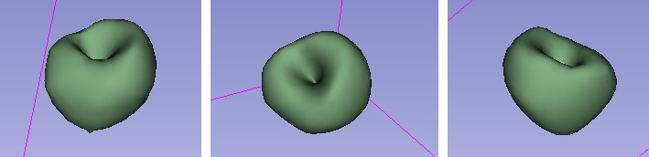
Labeling
Open Source Software – 3D Slicer
Widely used for medical research
Two segmentations maps are defined on a few slices:
Seeds on area of interest
Seeds outside of area of interest
“Grow from seeds” built in algorithm – expands the area of interest based on pixel intensities.
The resulting 3D binary mask can be exported.

Slide 14
Exploratory Data analysis
Data set contained 102 patients, 10 were chosen randomly were annotated with 3D Slicer.
3D SPECT volumes had a width and height dimensions of 64, 128, 62 or 81 pixels.
Min. and Max. number of slices in the volumes were 17 and 128, Mean was 56.
Annotated volumes:
Positive slices – at least one pixel belongs to the target class (left ventricle of the heart)
Ratio of positive slices was 26.5% on average, Min. and Max. values were 12.5% and 64.7%.
Ratio of positive pixels was 0.7% on average, Min. and Max. values were 0.1% and 2% among the volumes.
The statistics indicated extreme class imbalance!
Medical images contain a lot of noise. The order of the axes was not standardized – had to be manually adjusted for each patient to have an order of (C, W, H, D) – channels, width, height and depth.

Slide 15
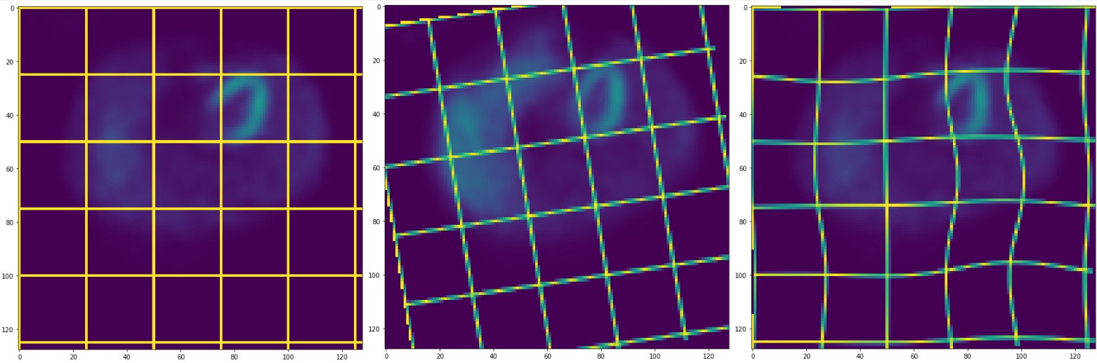
Preprocessing
Offline – preprocessing takes place before the training procedure:
Volumes were cropped along width/height dimensions until the point from where the pixels were 0 – negligible impact due to noise.
Volumes were resized along the width and height dimensions to have a shape of 128x128, using linear interpolation.
Online – preprocessing takes place during the training (randomized for each sample in each epoch):
Heavy augmentation pipeline with separated, probabilistic subparts (TorchIO).
Z-normalization - patches were normalized independently according to papers.
“CropOrPad” (32 slices for depth), “RandomFlip” along each dimension, “Blur”, “GauissanNoise”, “Random Affine”, “RandomElastic” transformations.

Slide 16
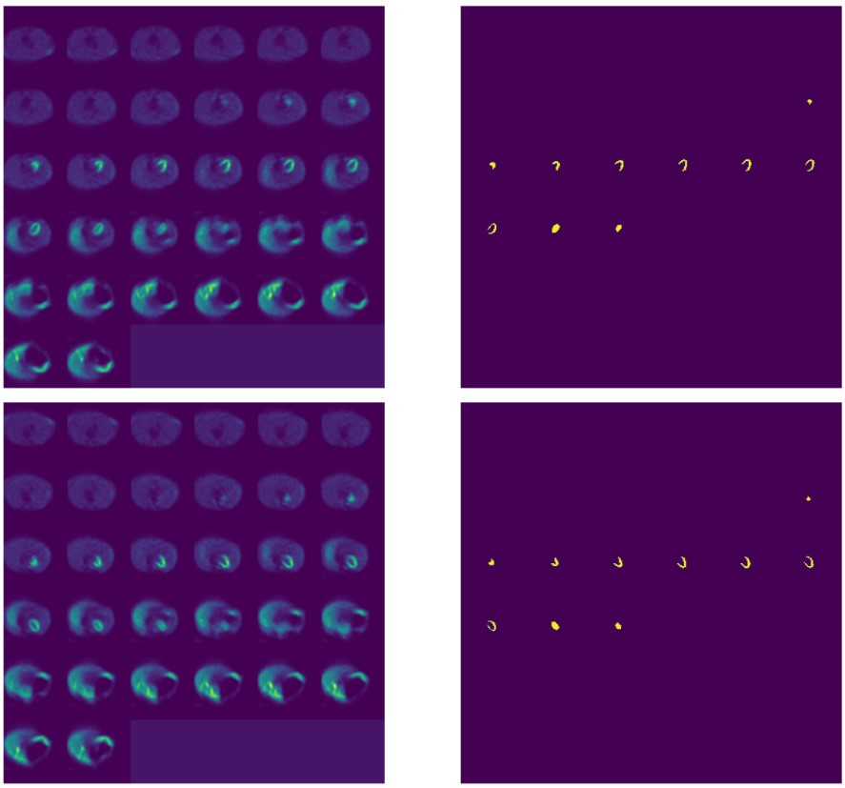
Pipeline illustration
Volumes were cropped or padded to 32 slices.
When mask was provided, the same augmentations are applied for both volumes.
Augmentations improves the model’s robustness by increasing the size of the training data set.

Slide 17
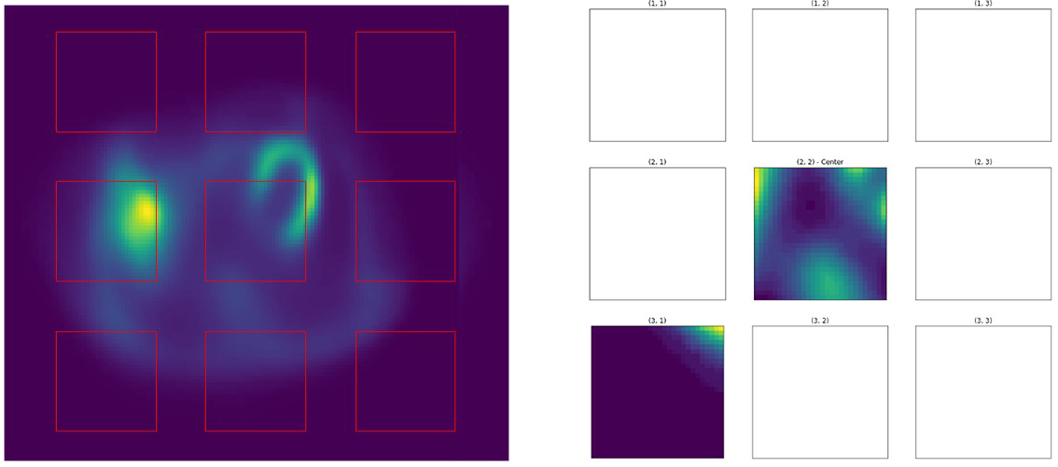
Representation learning from context prediction
Relative patch location pretext task

Slide 18
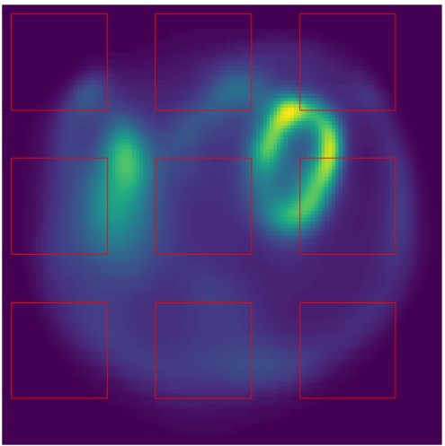
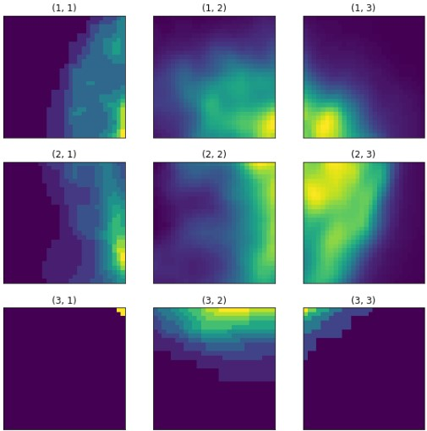
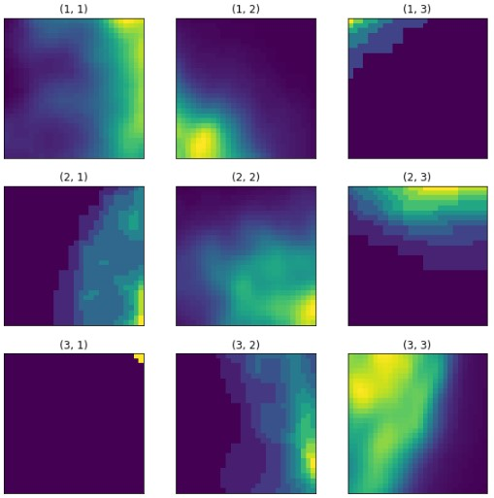
Representation learning from solving jigsaw puzzles of spect volumes
Pre-computed set of permutations with maximized Hamming distance between each permutation.
Cardinality of the permutation set was 1000. (500 was easy for the network to learn, which resulted in lower quality of learned features).
Predict which permutation was the randomly selected one out of the 1000.

Slide 19
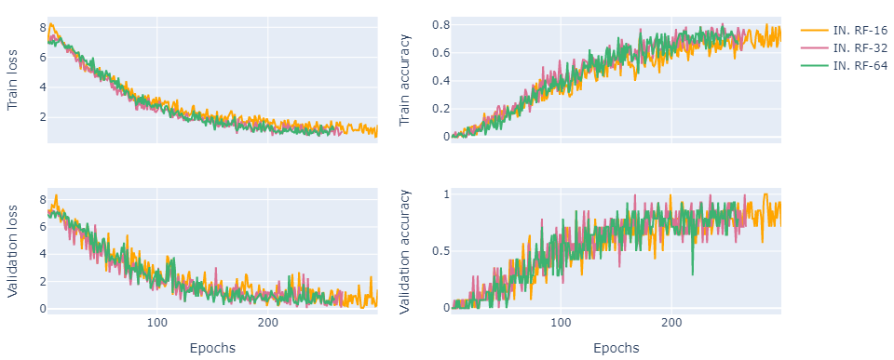
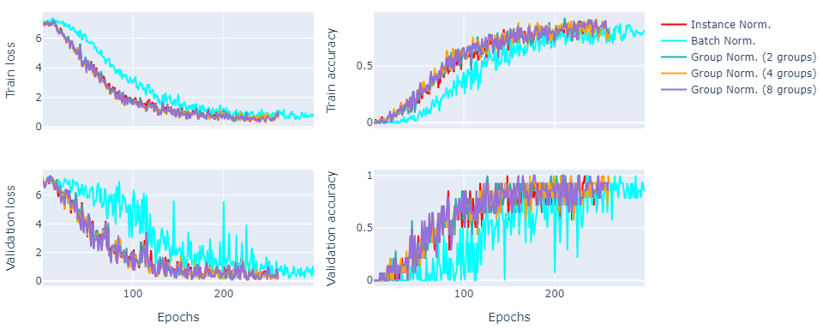
Experiments
Training on 72 patients with a lot of augmentations and validating on 20 patients.
“RF-32” produced the best results on the validation set, although all of them produced comparable results.
Instance Normalization and Group Normalization with 2 groups produced the best results.
Batch Normalization caused the validation performance to oscillate/collapse several times.

Slide 20
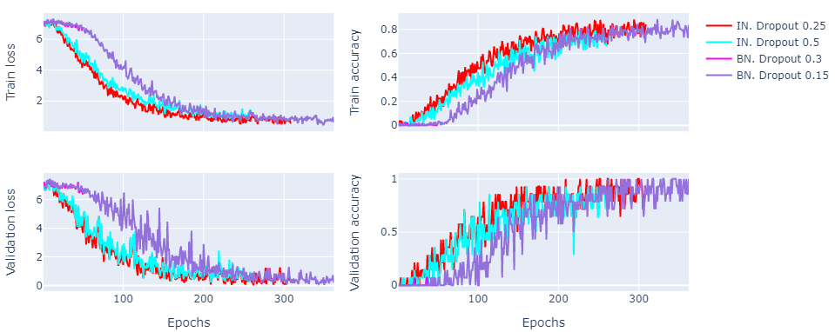
Experiments
Model with Dropout rate of 0.25 obtained the validation accuracy of 1.0 for the first time. Over Dropout rate of 0.25, the models struggled to reach the perfect accuracy score on the validation set.
The best weights were saved according to the validation performance.

Slide 21
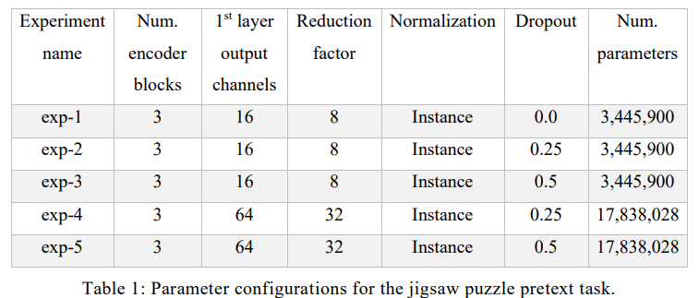
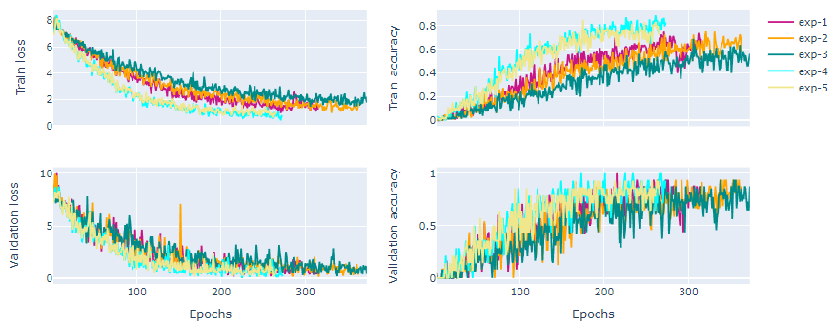
Experiments
Model of “exp-4” was the first to reach the validation accuracy of 1.0.
This model had 4x more output channels in the 1st layer, than the second best model of “exp-1”.
More feature maps resulted in better segmentation results on the target task as well.

Slide 22
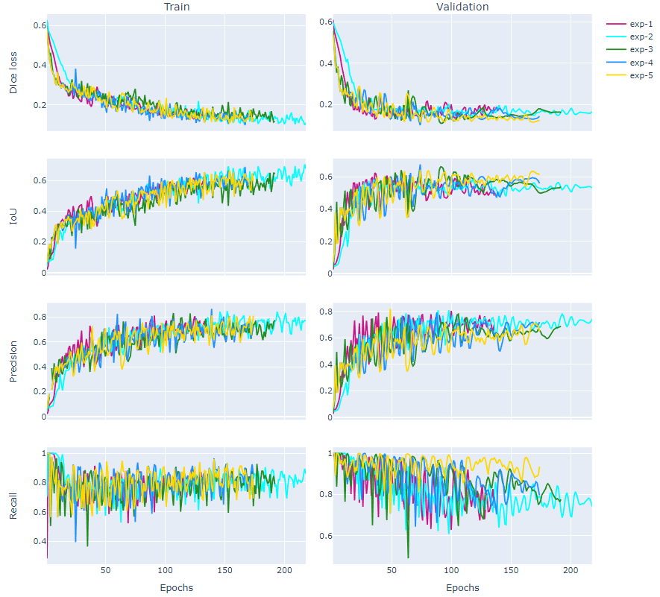
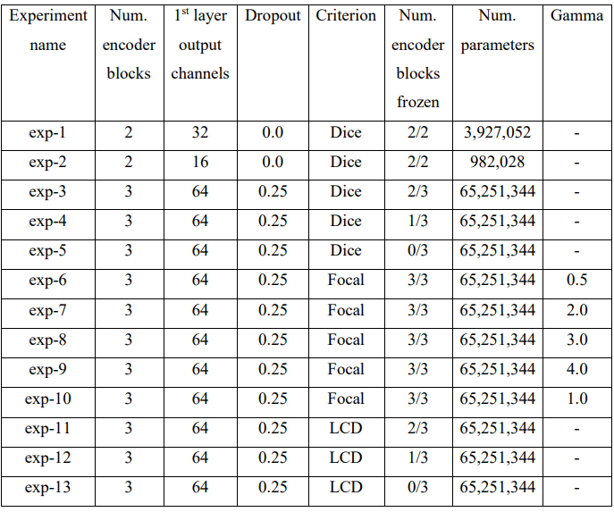
Supervised fine-tuning experiments
Training on 6 patients, validating on only 4 patients!
“exp-4”:
IoU – 0.678 at epoch 73
Precision: 0.748 - ~75% of the positively classified pixels were correct
Recall: 0.885 - ~88% of the pixels were found that corresponded to the left-ventricle

Slide 23
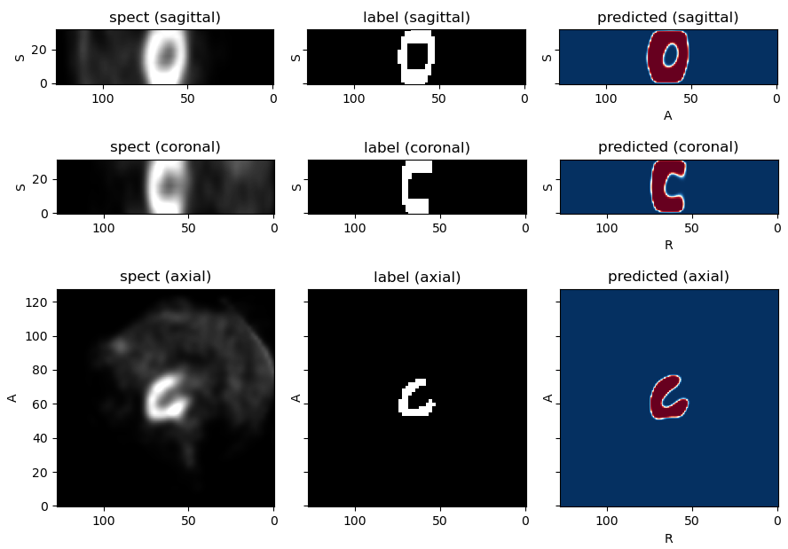
Left ventricle segmentation from 3D spect volumes - RESULTS

Slide 24
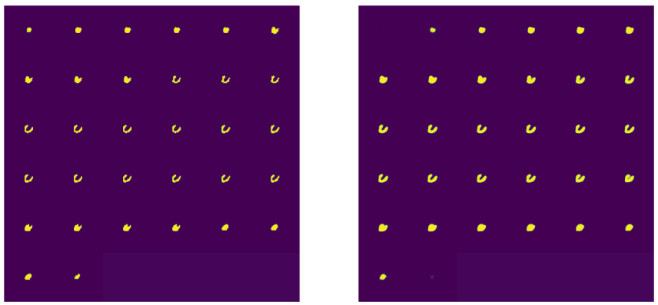
Left ventricle segmentation from 3D spect volumes - RESULTS

Slide 25
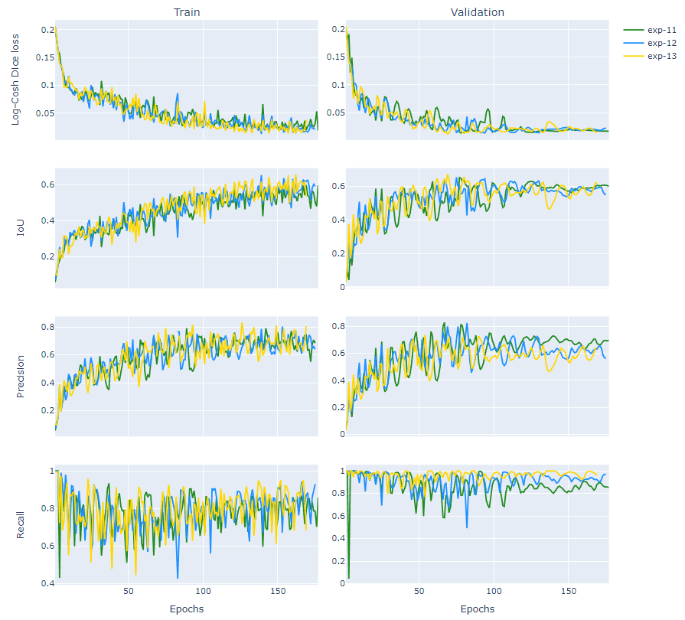
Supervised fine-tuning experiments
Training on 6 patients, validating on only 4 patients!
“exp-13”:
IoU – 0.673 at epoch 73
Precision: 0.693 - ~69% of the positively classified pixels were correct
Recall: 0.958 - ~96% of the pixels were found that corresponded to the left-ventricle

Slide 26
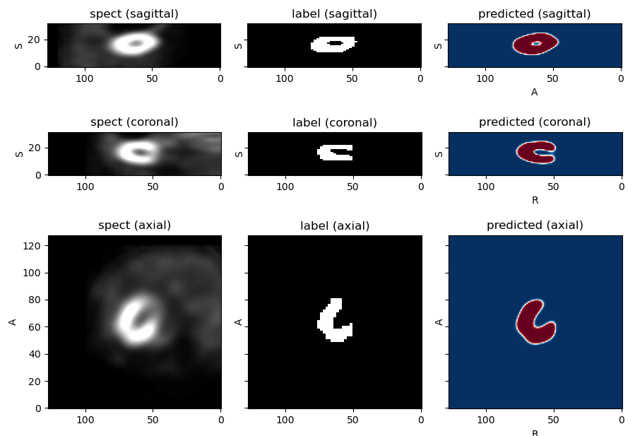
Left ventricle segmentation from 3D spect volumes - RESULTS

Slide 27
Thank you for your attention!

